Slide 1

Audio File Editor
Research synopsis,
Tutorial,
and
App Demonstration
PROJECT BY
Lucas Friesen

Slide 2
Research synopsis
MediaPlayer Class
Used to control playback of audio/video files and streams
PlaybackParams Structure
Used to control playback behaviour

Slide 3
MediaPlayer Class
Main Uses
Play
Pause
Stop
Other Uses
Loop
Seek
Volume

Slide 4
MediaPlayer Class
Useful Methods
start();
pause();
stop();
release();
getDuration();
seekTo();
setLooping();
setVolume();
getCurrentPosition();
setPlaybackParams();

Slide 5
PlaybackParams Structure
Audio Manipulation Via
Speed Retrieval
Speed Setting
Pitch Retrieval
Pitch Setting

Slide 6
PlaybackParams Structure
Useful Methods
getSpeed();
setSpeed();
getPitch();
setPitch();

Slide 7
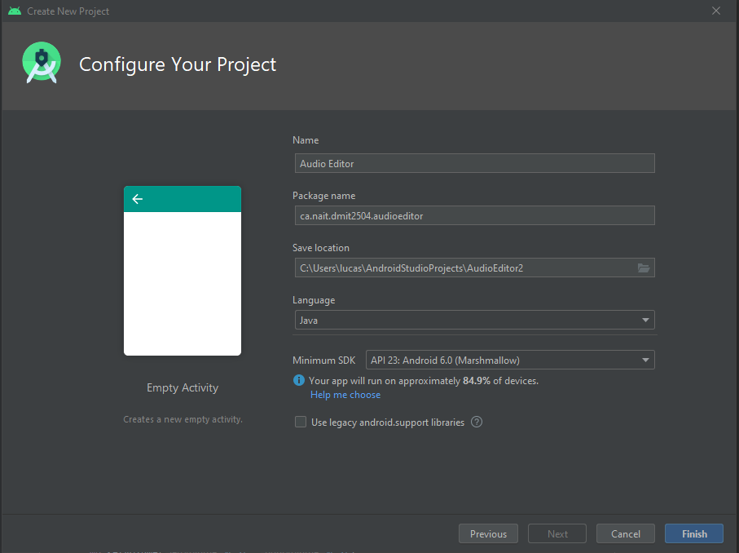
Audio Editor App Tutorial
1. Create New Empty Project

Slide 8
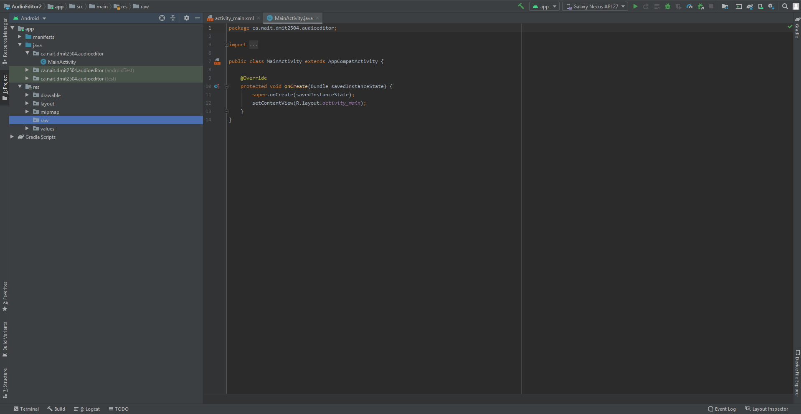
Audio Editor App Tutorial
2. Create new directory named
“raw” in the resource directory

Slide 9
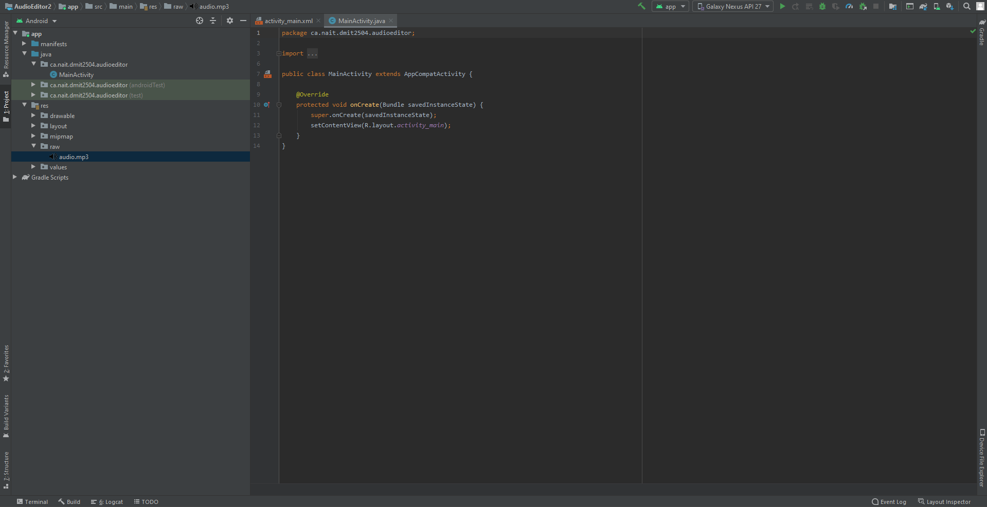
Audio Editor App Tutorial
3. Add your mp3 file
To new raw directory

Slide 10
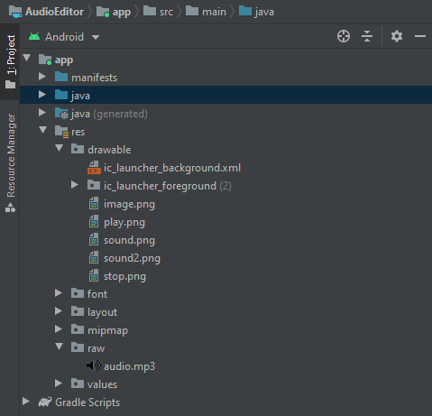
Audio Editor App Tutorial
4. Add 4 image files for
media player UI icons
(Images can be accessed on GitHub)

Slide 11
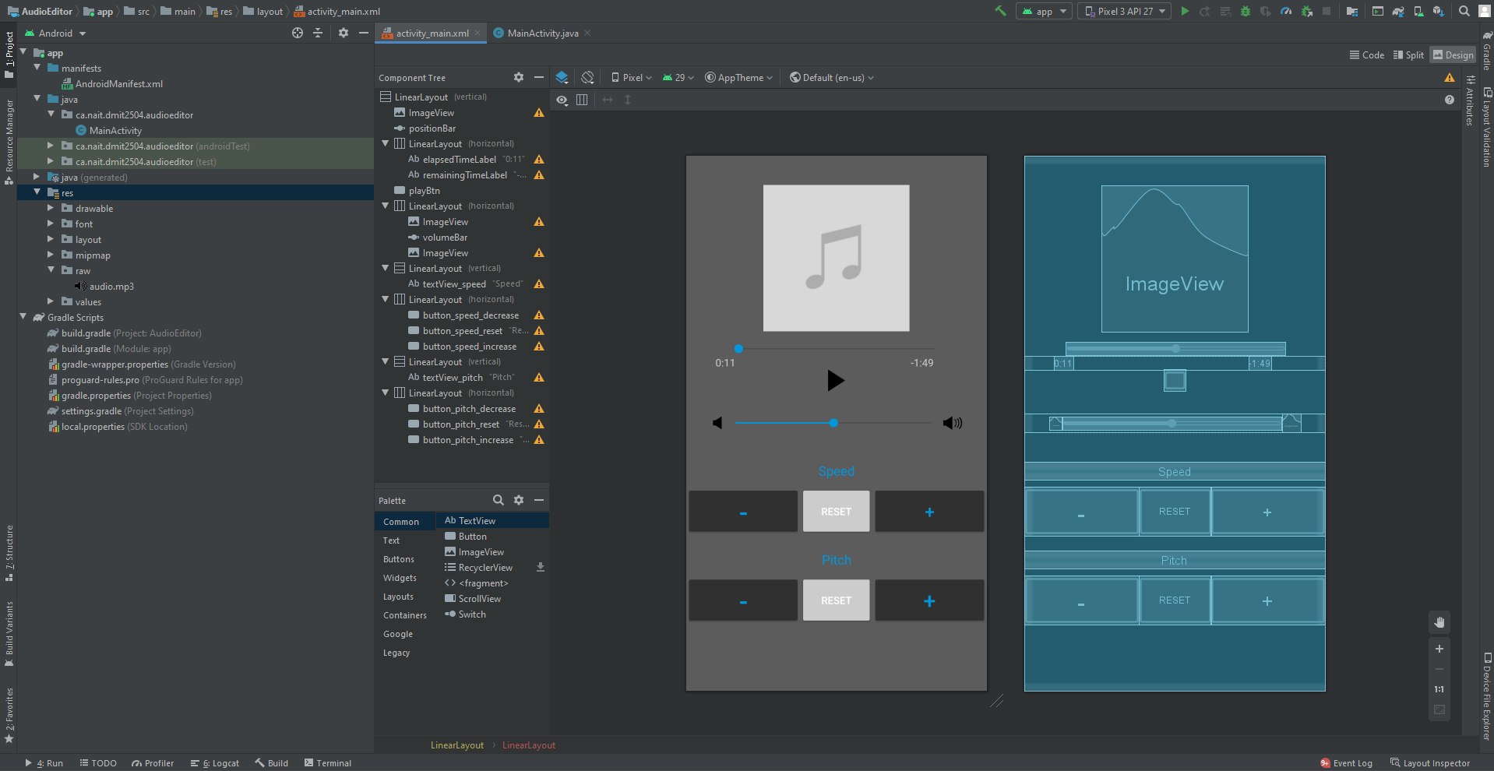
Audio Editor App Tutorial
5. Create UI for media player
and audio editor buttons in
“activity_main.xml”
(Code behind can be found on GitHub)

Slide 12
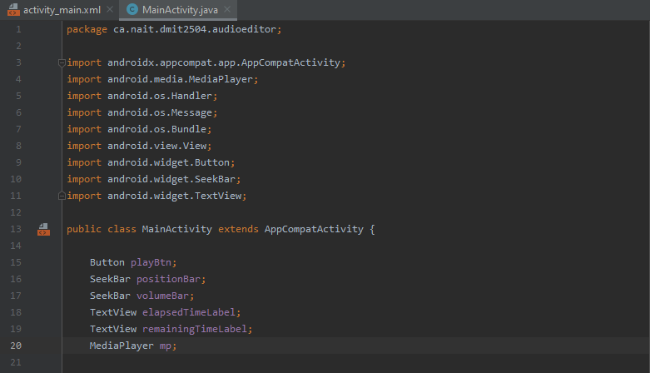
Audio Editor App Tutorial
6. Create the variables shown
for the app’s UI buttons, widgets,
and media player

Slide 13
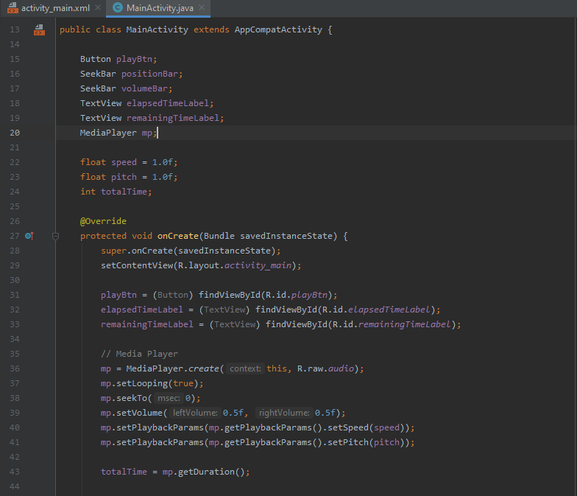
Audio Editor App Tutorial
7. In the onCreate method
apply variables to id values
and create MediaPlayer

Slide 14
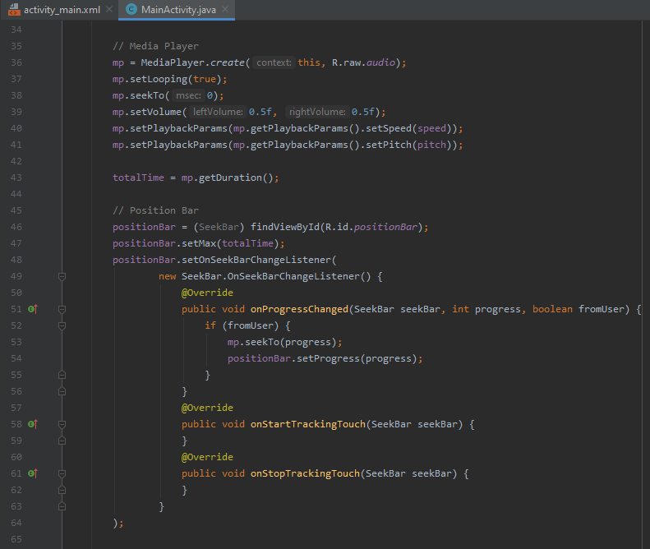
Audio Editor App Tutorial
8. Implement Java code for
media player seek bar widget

Slide 15
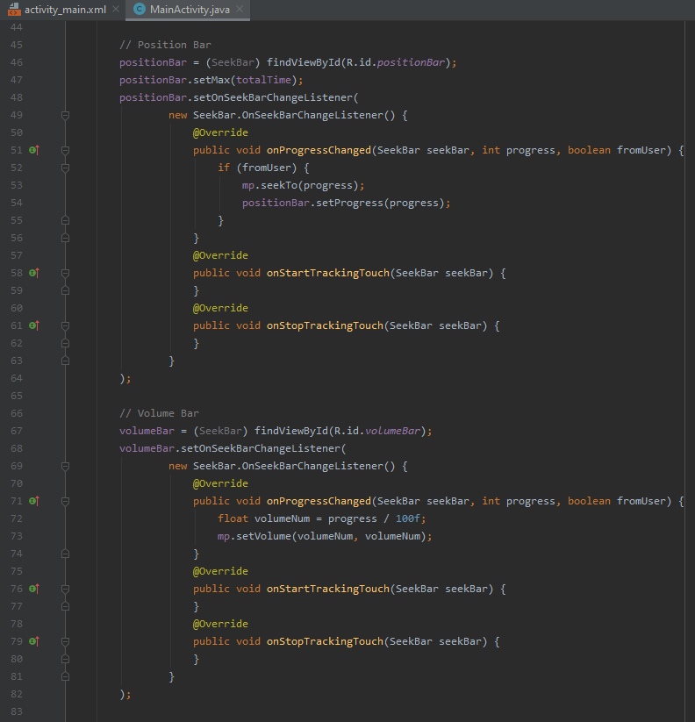
Audio Editor App Tutorial
9. Implement Java code for
audio volume control with
seek bar widget

Slide 16
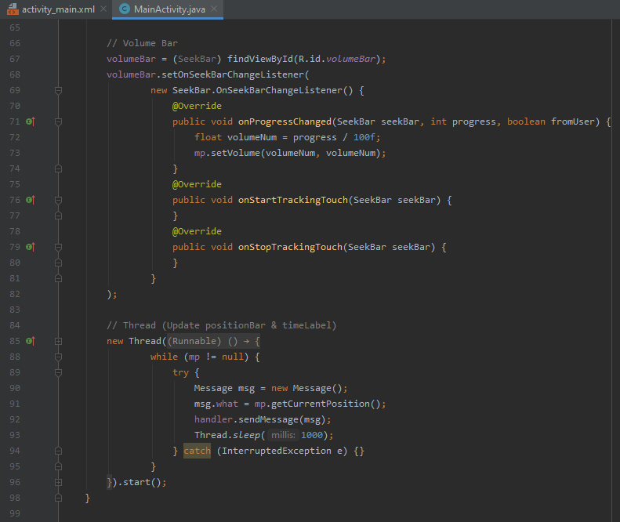
Audio Editor App Tutorial
10. Implement Java code for
the updating of the position
bar and time label using a thread

Slide 17
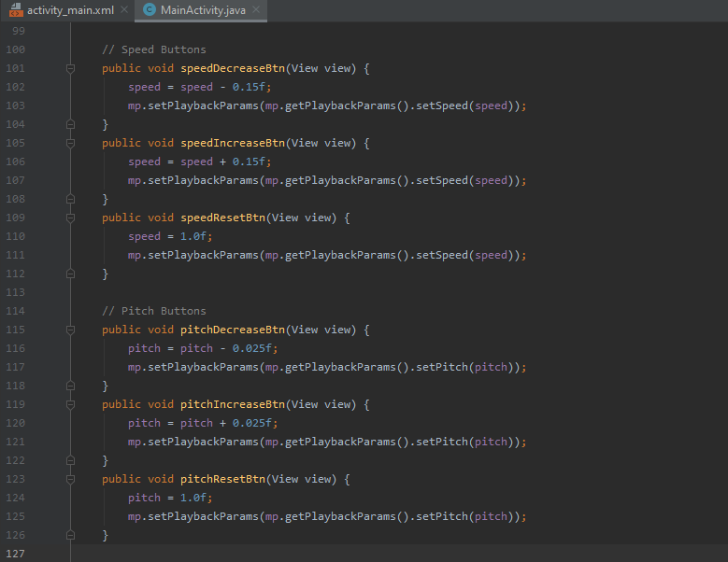
Audio Editor App Tutorial
11. Create onClick button
counters to increase or decrease
speed and pitch
(Java code structure for speed and pitch are similar)

Slide 18
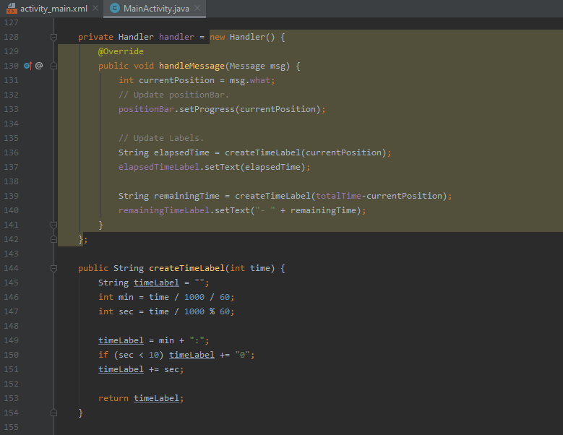
Audio Editor App Tutorial
12. Create handler for media
player audio progress and
create time label

Slide 19
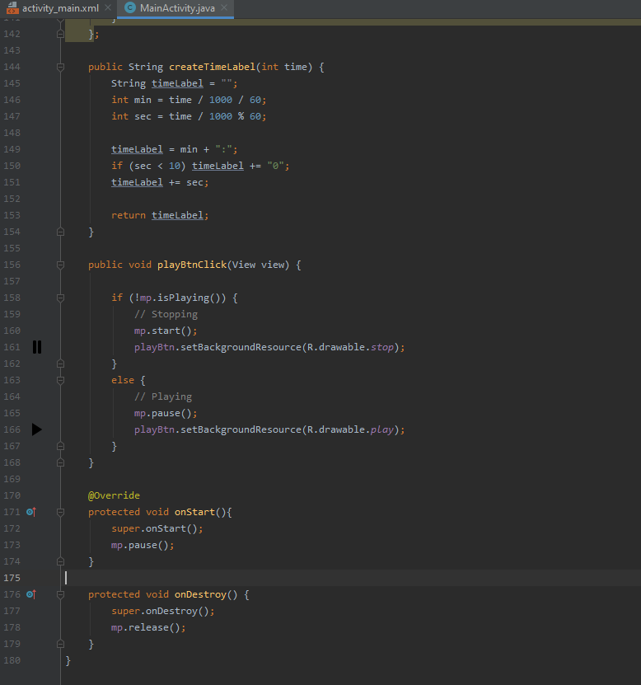
Audio Editor App Tutorial
13. Implement Java code for
play button

Slide 20
Audio Editor App Tutorial
14. Set whether media player
runs upon launching and release
player after app is terminated

Slide 21
Thank You

